Slide 1
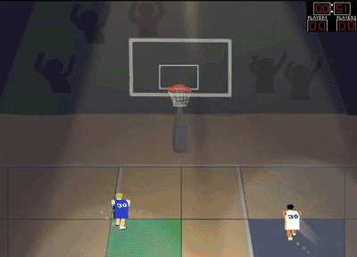
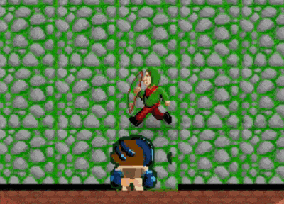
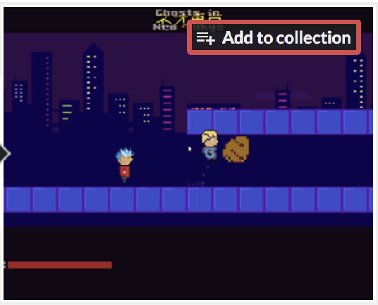
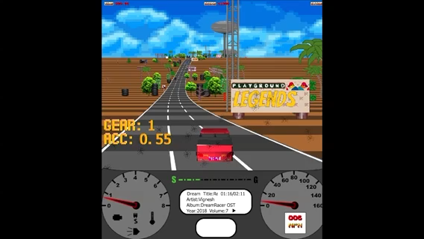

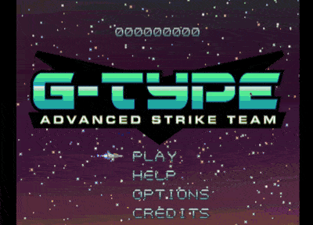
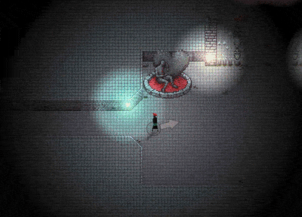

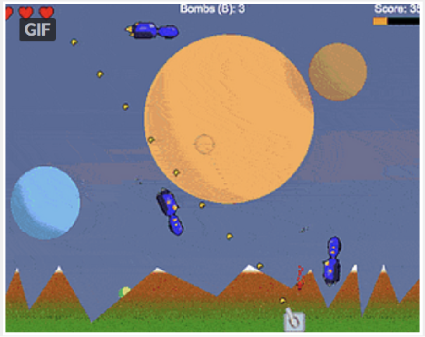
About me
Club member since Jan 27, 2018
Game Changer Since Q2 2018
Led:
Dream Racer
G-Type
Kung Twu
Contributed to:
Excalibur
GINT
In The Zone
Warped Radar
Falldale
Exit the Shadow
Little Racers
Quarter-finalist in SLC Nintendo World Championships 1990

